Slide 1

Seasonal Agriculture Performance Analysis
PUSHKAR GAUR
RAJ KUMAR GOEL INSTITUTE OF TECHNOLOGY
AICTE Student ID: STU6a5f4088577f51784627336

Slide 2

PROBLEM STATEMENT
Agricultural performance is influenced by seasonal variations in environmental conditions, farming practices, resource availability and market conditions.
Raw agricultural data does not clearly explain how performance changes across seasons or what patterns exist in different seasonal conditions.
This project analyzes the seasonal agriculture dataset to identify meaningful patterns, trends, relationships and differences in performance across the Kharif, Rabi and Zaid seasons.

Slide 3
Project Description
This project analyzes a seasonal agriculture dataset of 4,000 farm records across Kharif, Rabi and Zaid seasons to understand how agricultural performance varies with the seasons.
The dataset covers environmental conditions (rainfall, temperature, soil health), farming practices (irrigation, fertilizer use), yield and production, and economic outcomes (cost, revenue, profit).
Using Python, the data is cleaned, explored through univariate, bivariate and multivariate visualizations, and tested statistically to uncover evidence-based seasonal patterns and actionable recommendations.

Slide 4

WHO ARE THE END USERS?
Farmers - to plan sowing, irrigation and resource use around season-wise performance.
Agricultural Extension Officers & Agronomists - to guide farmers with evidence-based seasonal advisories.
Government & State Agriculture Departments - for evidence-based seasonal policy and planning.
Agri-Business & Supply Chain Companies - for demand, pricing and input planning across seasons.
Researchers & Data Analytics Students - as a reference case study in agricultural data analysis.

Slide 5

Technology Used
  Python - core programming language for the analysis
  Pandas & NumPy - data cleaning, wrangling and computation
  Matplotlib & Seaborn - univariate, bivariate and multivariate visualizations
  SciPy - statistical hypothesis testing (ANOVA)
  Google Colab / Jupyter Notebook - development environment

Slide 6
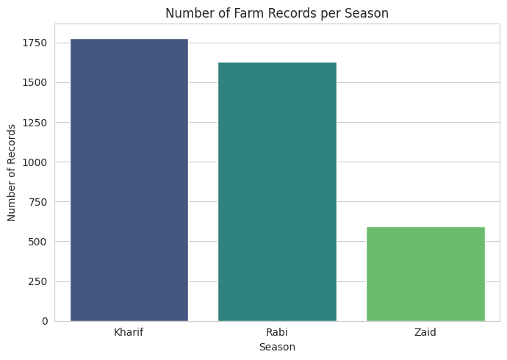
RESULT 1: Seasonal Distribution of Records
Kharif season accounts for the highest number of farm records, followed by Rabi; Zaid has the fewest — reflecting monsoon dependency.

Slide 7
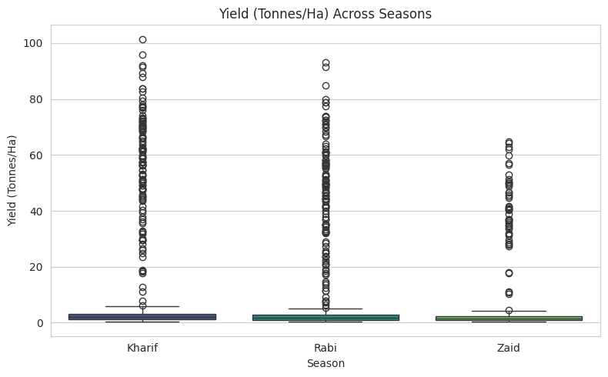
RESULT 2: Yield Across Seasons
Average yield is broadly similar across seasons. A one-way ANOVA shows this difference is NOT statistically significant (p ≈ 0.21).

Slide 8
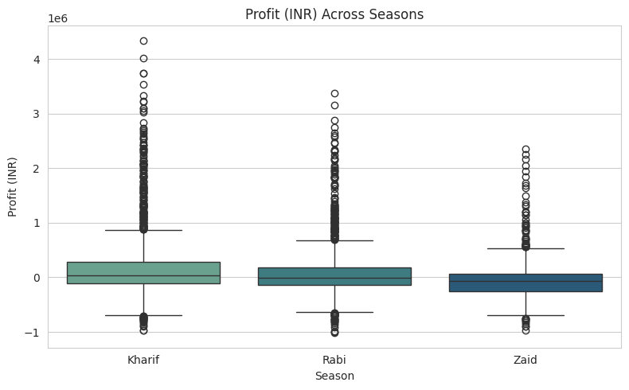
RESULT 3: Profit Across Seasons
Profit varies significantly across seasons (ANOVA, p < 0.05) — season shapes farm economics more strongly than raw yield.

Slide 9
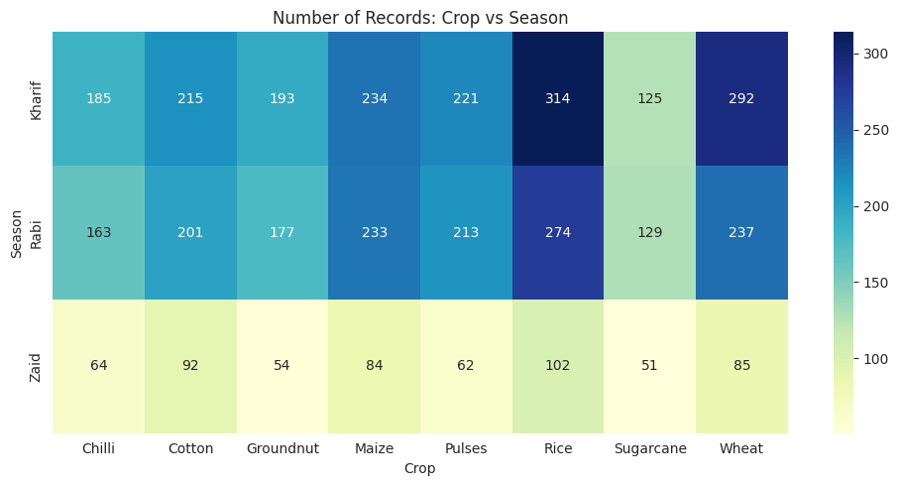
RESULT 4: Crop Distribution Across Seasons
Rice is the most-recorded crop in every season, while Sugarcane and Groundnut appear least often — the overall crop mix stays broadly consistent, but volumes shift with each season.

Slide 10
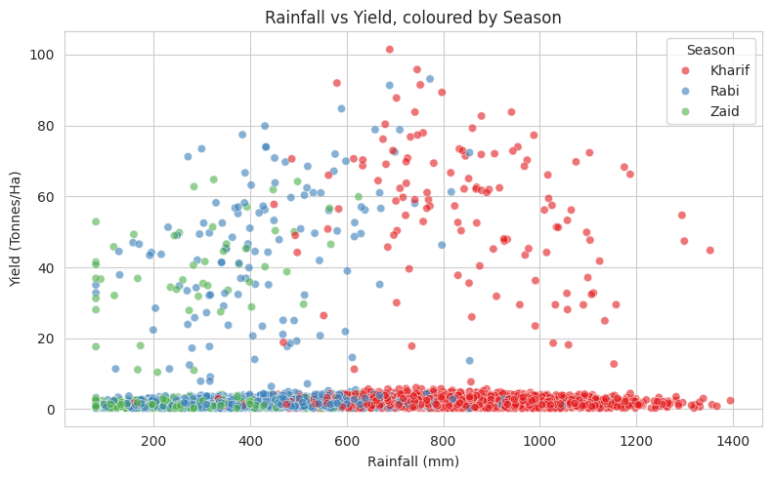
RESULT 5: Rainfall vs Yield Relationship
Yield generally trends upward with rainfall, though the relationship differs by season — highlighting season-specific water needs.

Slide 11
Future scope
Incorporate region-specific (state/district level) seasonal recommendations, since agro-climatic conditions vary geographically.
Build a predictive model to forecast yield or profit for an upcoming season using historical patterns.
Develop an interactive dashboard so farmers and planners can explore seasonal trends themselves.
Extend the analysis with real-time weather and market-price data feeds for continuously updated insights.

Slide 12
GitHub Link
The complete project - Jupyter notebook, dataset, and README - is available on GitHub:
https://github.com/pushkargaur09/Pushkar_Gaur_Seasonal_Agriculture_Performance_Analysis
If the link above doesn't open directly, copy-paste this URL into your browser:
https://github.com/pushkargaur09/Pushkar_Gaur_Seasonal_Agriculture_Performance_Analysis.git

Slide 13

VOIS Course completion certificate -
Course name- Data Visualization

Slide 14
Thank you
.
.

